Slide 1
CAD Project: Skin Lesion Classification
Kazi Saeed Alam, Gonzalo Esteban Mosquera Rojas

Slide 2
Objectives
Skin Lesion Classification : Binary and Three-Class Problem
Questions to be solved. What is the best pipeline for classification?
With or without pre-processing?
Hair Removal and/or vignette removal?
Data Augmentation or Over Sampling/SMOTE? (for imbalanced class Problem)
Feature Extraction Techniques?
Feature Selection?
Classifier Selection?
Ensemble Classifiers?

Slide 3
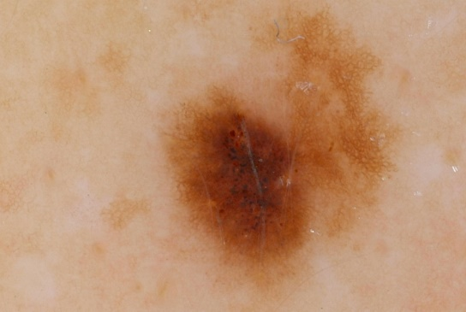
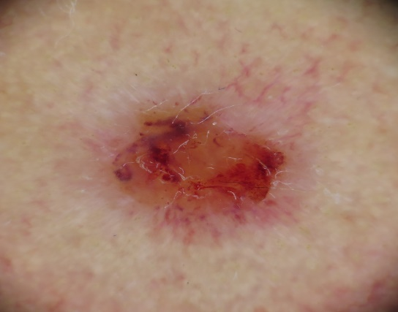
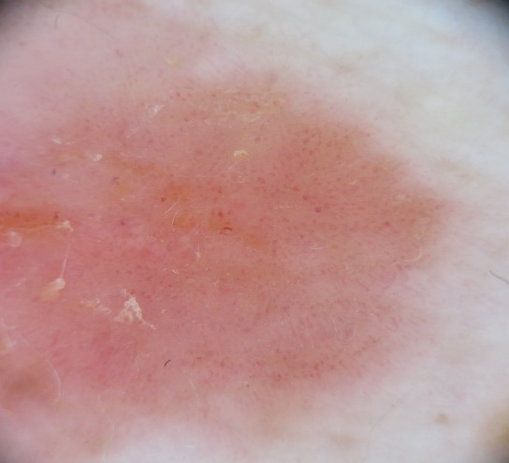
Overview
Binary problem: nevus vs others
Three class problem: mel (melanoma), bcc (basal cell carcinoma), scc (squamous cell carcinoma)
Two main ways of tackling the problems: classification with raw images and with preprocessed images.
11 different classifiers trained on 7 different feature set.
Class Imbalance treatment: Data augmentation and oversampling.
melanoma
bcc
scc

Slide 4
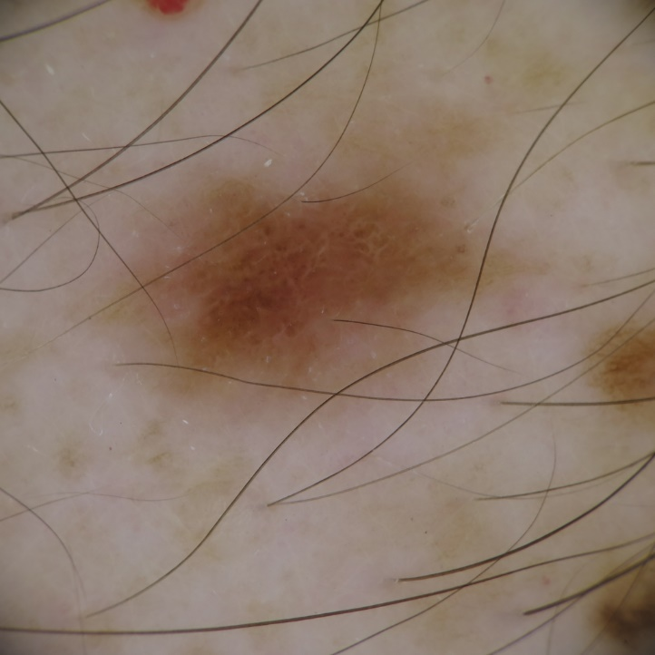
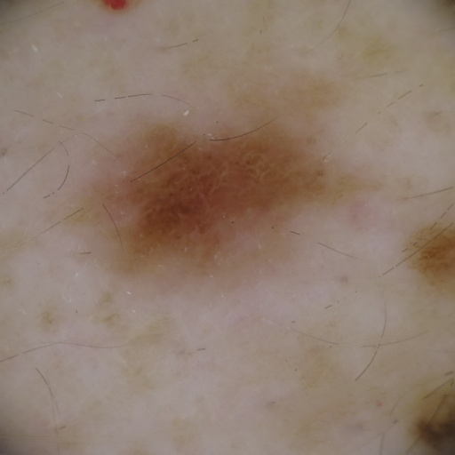
Preprocessing (Hair Removal)
Sum of rotating Top-Hats Transforms
Morphological Operation
Image Inpainting

Slide 5
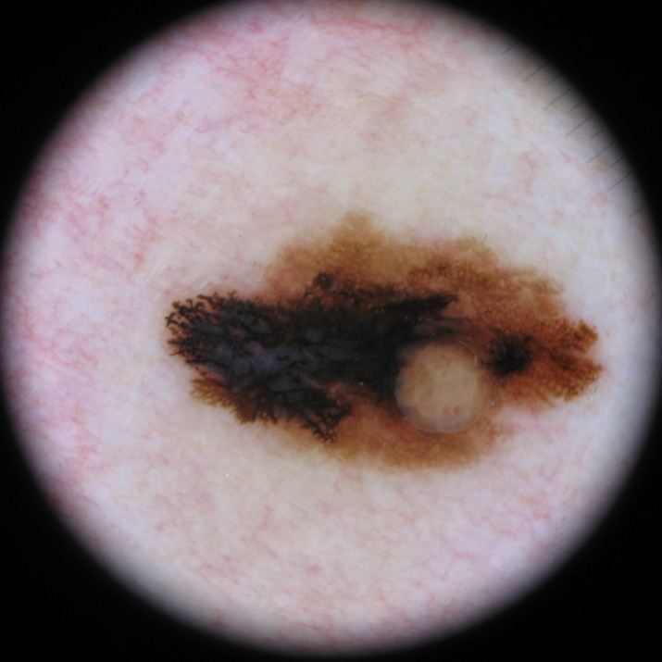
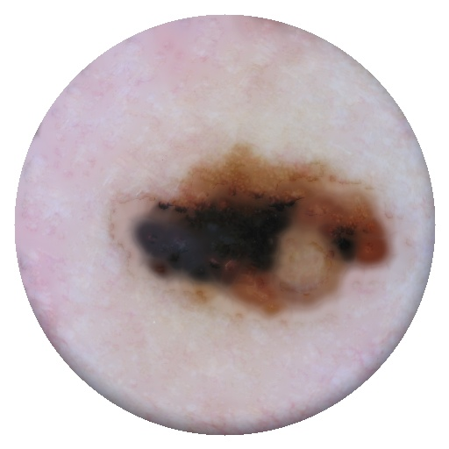
Preprocessing (Vignette Removal)
Creating Circular Mask
Counting the number of black pixels around the mask
Reduce the radius according to a threshold

Slide 6

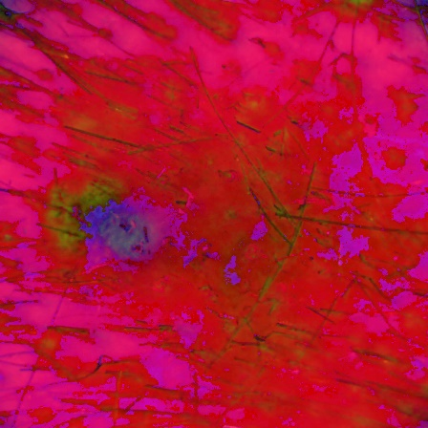
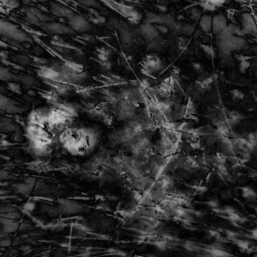
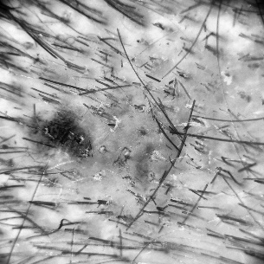
Preprocessing (Histogram Equalization)
Contrast limited adaptive histogram equalization.
Histogram equalization on smaller tiles of images(8*8).
HSV Image

Slide 7
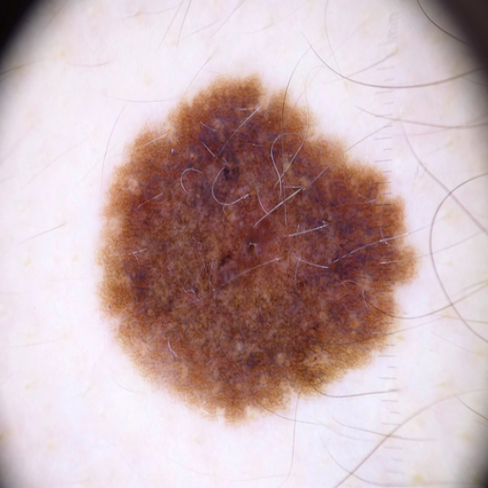
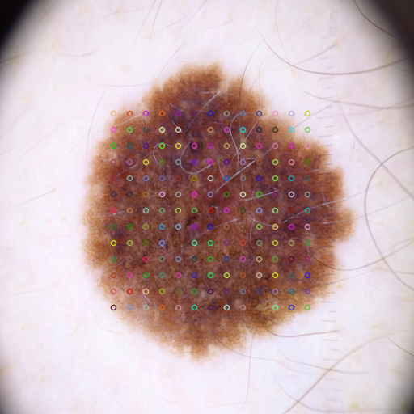
Feature Extraction: SIFT + BoW
200 randomly chosen images are used for vocabulary creation
The number of clusters for BoW was kept 200
Dense sift descriptors were used

Slide 8
Feature Extraction: Color Histograms
Concatenated histogram of R, G and B channels
Histogram bins: 64
Number of features: 192
For each channel, the following statistics were extracted: min, max, mean, std, skew. Channels analyzed (RGB and HSV)
Number of features: 30
In some experiments for the three class problem, histogram equalization was performed in the image.

Slide 9
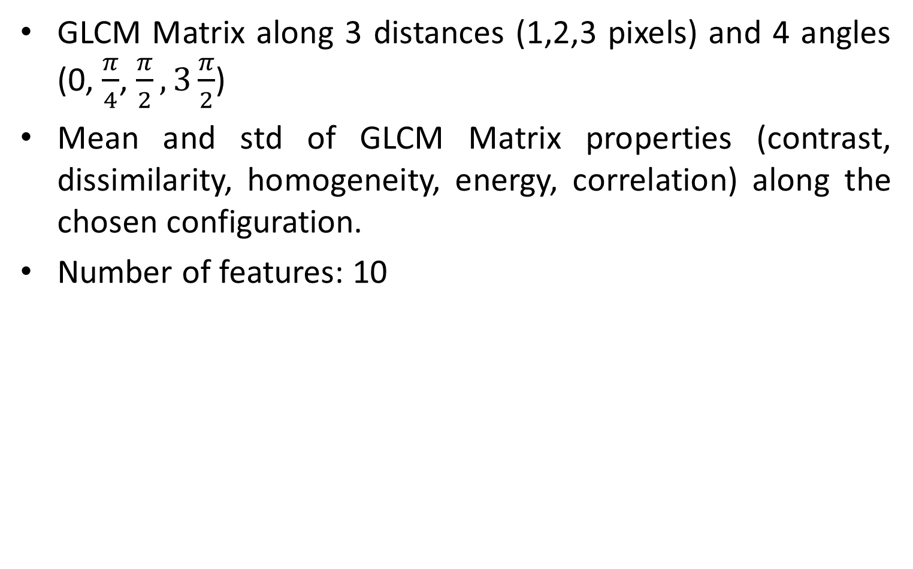
Feature Extraction: GLCM Texture features

Slide 10
Feature extraction: LBP Texture features
LBP concatenated histograms for 3 cases (P,R): (8,1), (16,2), (24,3).
Number of features: 54
Statistics of LBP histograms for the 3 chosen cases: mean, std, kurtosis, skew, entropy:
Number of features 15

Slide 11
Feature Extraction: SIFT + BoW
200 randomly chosen images are used for vocabulary creation
The number of clusters for BoW was kept 200 (Features)
Dense sift descriptors were used
Total number of features: 500

Slide 12
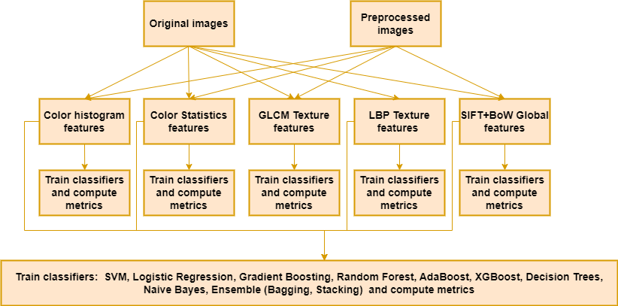
Two class Problem: Scheme Diagram

Slide 13
Two class problem: Results (I)
Case – 1 : Without Preprocessing
Features | SVM | LR | Gboost | RF | Adaboost | Decision Trees | XGBoost | Naive Bayes | KNN | Ensemble
 |  |  |  |  |  |  |  |  |  | Bagging | Stacking
CH | 0,750 | 0,674 | 0,768 | 0,801 | 0,730 | 0,713 | 0,765 | 0,628 | 0,750 | 0,803 | 0,804
CS | 0,782 | 0,739 | 0,768 | 0,793 | 0,734 | 0,716 | 0,763 | 0,629 | 0,753 | 0,793 | 0,795
GLCM | 0,696 | 0,649 | 0,696 | 0,717 | 0,649 | 0,641 | 0,688 | 0,574 | 0,682 | 0,725 | 0,728
LBPH | 0,734 | 0,726 | 0,713 | 0,745 | 0,699 | 0,666 | 0,715 | 0,653 | 0,722 | 0,745 | 0,761
LBPS | 0,672 | 0,667 | 0,685 | 0,712 | 0,661 | 0,660 | 0,700 | 0,588 | 0,682 | 0,713 | 0,715
SIFT + BoW | 0,757 | 0,743 | 0,749 | 0,762 | 0,738 | 0,676 | 0,745 | 0,726 | 0,739 | 0,756 | 0,768
All | 0,822 | 0,804 | 0,807 | 0,820 | 0,773 | 0,728 | 0,805 | 0,723 | 0,788 | 0,820 | 0,830

Slide 14
Two class problem: Results (I)
Case – 2 : With Preprocessing
Features | SVM | LR | Gboost | RF | Adaboost | Decision Trees | XGBoost | Naive Bayes | KNN | Ensemble
 |  |  |  |  |  |  |  |  |  | Bagging | Stacking
CH | 0,767 | 0,671 | 0,778 | 0,801 | 0,738 | 0,695 | 0,770 | 0,684 | 0,736 | 0,795 | 0,800
CS | 0,784 | 0,714 | 0,774 | 0,793 | 0,741 | 0,700 | 0,773 | 0,630 | 0,763 | 0,786 | 0,795
GLCM | 0,725 | 0,691 | 0,717 | 0,727 | 0,706 | 0,641 | 0,721 | 0,634 | 0,698 | 0,734 | 0,736
LBPH | 0,748 | 0,724 | 0,737 | 0,745 | 0,714 | 0,665 | 0,737 | 0,657 | 0,722 | 0,750 | 0,754
LBPS | 0,699 | 0,694 | 0,696 | 0,714 | 0,673 | 0,643 | 0,692 | 0,570 | 0,696 | 0,722 | 0,715
SIFT + BoW | 0,760 | 0,739 | 0,743 | 0,759 | 0,733 | 0,664 | 0,741 | 0,714 | 0,731 | 0,750 | 0,768
All | 0,817 | 0,793 | 0,805 | 0,815 | 0,778 | 0,711 | 0,806 | 0,743 | 0,779 | 0,817 | 0,830

Slide 15
Two class problem: Results (III)
Taking only the original images, an ensemble of classifiers with majority voting was constructed under the following three scenarios:
Ensemble of the 3 best standalone classifiers for each feature set, and then ensemble of the resulting ensemble classifier from each feature set.
Ensemble of the best standalone classifier for each feature set
Ensemble of the best overall classifier for each feature set (ensemble of stacking classifiers)
Ensemble Model | Balanced accuracy
Model 1 | 0,781
Model 2 | 0,802
Model 3 | 0,824

Slide 16
Two class problem: results (IV)
Another experiment was carried out, where the best standalone model for the best feature set (dataset without preprocessing, SVM, all features), was retrained on all possible combinations of features to determine the optimum number of features using SelectKBest function. It was obtained that with 415 features, SVM obtains an accuracy score of 0.8245 as opposed to 0.822 with 500 features.

Slide 17
Two class problem: results (V)
Overall, results are very similar with and without preprocessing. However, models trained on dataset without preprocessing perform slightly better results and it is computationally less expensive, so it was decided to use this approach for the final pipeline selection.

Slide 18
Two class problem: results (VI)
Random Forest classifier proved to be the best model along all experiments as a standalone classifier. However, for all cases Stacking classifier gets the highest performance, so it was decided to keep this model for the final pipeline selection.

Slide 19
Two class problem: results (VII)
Finally, when evaluating all experiments, using a Stacking classifier with all features yields the highest balanced accuracy, therefore, this is used as the final pipeline for generating predictions on test set.

Slide 20
Two class problem: Best model
Stacking of classifiers trained on data without preprocessing and using all features.
Stacking of classifiers: using the output of each individual classifier as input of a final classifier
Classifiers used for the stacking: LR, KNN, Decision Tree, SVM, Bayes, Gboost, RF, Adaboost
Final Classifier: LR

Slide 21
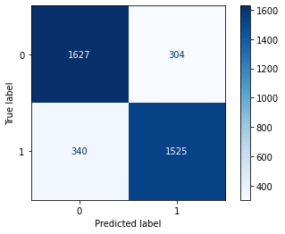
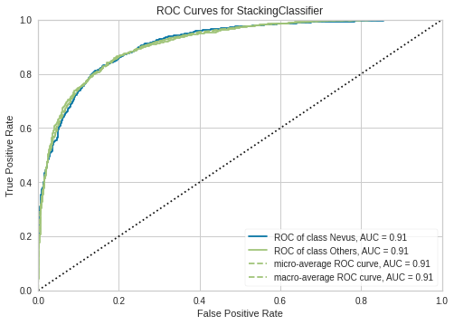
Two class problem: Best model
Class | Precision | Recall | F1-Score
0 | 0.83 | 0.84 | 0.83
1 | 0.83 | 0.82 | 0.83

Slide 22
Two class problem: conclusions
The overall results for the validation set are good. The misclassification errors for both classes are very similar, which is theoretically correct as the classes are balanced.
Using an ensemble of stacking classifiers trained on each feature set did not perform better than a single stacking classifier trained on all features.

Slide 23
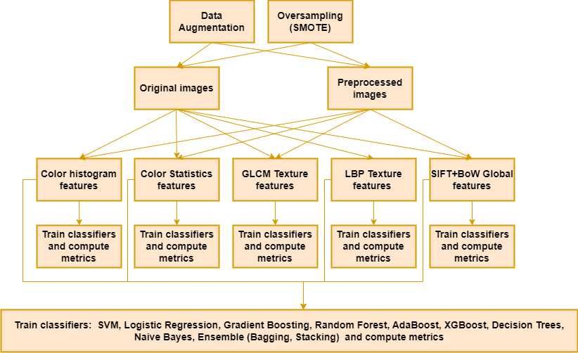
Three class Problem: Scheme Diagram

Slide 24
Three class Problem: Results(I)
Case – 1 : Without Preprocessing + Data Augmentation (Balanced Accuracy)
Feature Extractor | SVM | LR | GBoost | RF | Adaboost | Decision Trees | XGBoost | Naive Bayes | KNN | Ensemble
 |  |  |  |  |  |  |  |  |  | Bagging | Stacking
CHF | 0.667 | 0.54 | 0.686 | 0.744 | 0.565 | 0.621 | 0.651 | 0.428 | 0.674 | 0.746 | 0.756
CSF | 0.648 | 0.534 | 0.627 | 0.696 | 0.581 | 0.588 | 0.622 | 0.429 | 0.651 | 0.688 | 0.71
GLCM | 0.507 | 0.464 | 0.51 | 0.562 | 0.476 | 0.514 | 0.508 | 0.454 | 0.518 | 0.539 | 0.564
LBPH | 0.464 | 0.457 | 0.467 | 0.515 | 0.402 | 0.475 | 0.446 | 0.419 | 0.473 | 0.51 | 0.522
LBPS | 0.409 | 0.372 | 0.408 | 0.451 | 0.401 | 0.433 | 0.432 | 0.34 | 0.431 | 0.441 | 0.462
SIFT + BoW | 0.587 | 0.56 | 0.57 | 0.586 | 0.527 | 0.473 | 0.561 | 0.517 | 0.596 | 0.566 | 0.614

Slide 25
Three class Problem: Results(I)
Case – 2 : Without Preprocessing + Smote (Balanced Accuracy)
Feature Extractor | SVM | LR | GBoost | RF | Adaboost | Decision Trees | XGBoost | Naive Bayes | KNN | Ensemble
 |  |  |  |  |  |  |  |  |  | Bagging | Stacking
CHF | 0.69 | 0.543 | 0.682 | 0.71 | 0.592 | 0.591 | 0.635 | 0.457 | 0.698 | 0.731 | 0.733
CSF | 0.634 | 0.541 | 0.643 | 0.673 | 0.574 | 0.558 | 0.635 | 0.458 | 0.631 | 0.693 | 0.645
GLCM | 0.546 | 0.506 | 0.558 | 0.615 | 0.506 | 0.527 | 0.548 | 0.41 | 0.578 | 0.625 | 0.613
LBPH | 0.598 | 0.575 | 0.567 | 0.592 | 0.523 | 0.498 | 0.571 | 0.405 | 0.557 | 0.611 | 0.588
LBPS | 0.521 | 0.466 | 0.496 | 0.507 | 0.478 | 0.439 | 0.496 | 0.362 | 0.509 | 0.525 | 0.501
SIFT + BoW | 0.589 | 0.518 | 0.482 | 0.517 | 0.458 | 0.475 | 0.494 | 0.499 | 0.589 | 0.521 | 0.576

Slide 26
Three class Problem: Results(I)
Case – 3 : With Preprocessing + Data Augmentation (Balanced Accuracy)
Feature Extractor | SVM | LR | GBoost | RF | Adaboost | Decision Trees | XGBoost | Naive Bayes | KNN | Ensemble
 |  |  |  |  |  |  |  |  |  | Bagging | Stacking
CHF | 0.619 | 0.501 | 0.65 | 0.682 | 0.595 | 0.572 | 0.644 | 0.459 | 0.645 | 0.702 | 0.706
CSF | 0.602 | 0.52 | 0.584 | 0.652 | 0.536 | 0.543 | 0.576 | 0.437 | 0.632 | 0.636 | 0.669
GLCM | 0.55 | 0.503 | 0.568 | 0.59 | 0.492 | 0.477 | 0.55 | 0.446 | 0.552 | 0.611 | 0.595
LBPH | 0.572 | 0.579 | 0.548 | 0.589 | 0.514 | 0.495 | 0.535 | 0.463 | 0.556 | 0.597 | 0.599
LBPS | 0.497 | 0.472 | 0.527 | 0.554 | 0.459 | 0.46 | 0.523 | 0.349 | 0.492 | 0.546 | 0.562
SIFT + BoW | 0.577 | 0.541 | 0.562 | 0.591 | 0.508 | 0.442 | 0.554 | 0.484 | 0.575 | 0.588 | 0.599

Slide 27
Three class Problem: Results(III)
Case – 4 : With Preprocessing + Smote (Balanced Accuracy)
Feature Extractor | SVM | LR | GBoost | RF | Adaboost | Decision Trees | XGBoost | Naive Bayes | KNN | Ensemble
 |  |  |  |  |  |  |  |  |  | Bagging | Stacking
CHF | 0.647 | 0.518 | 0.637 | 0.658 | 0.57 | 0.545 | 0.623 | 0.458 | 0.656 | 0.666 | 0.661
CSF | 0.622 | 0.511 | 0.611 | 0.644 | 0.54 | 0.549 | 0.616 | 0.434 | 0.629 | 0.654 | 0.623
GLCM | 0.575 | 0.496 | 0.534 | 0.58 | 0.504 | 0.505 | 0.531 | 0.43 | 0.541 | 0.582 | 0.557
LBPH | 0.581 | 0.591 | 0.576 | 0.555 | 0.537 | 0.482 | 0.538 | 0.451 | 0.539 | 0.549 | 0.558
LBPS | 0.504 | 0.489 | 0.523 | 0.528 | 0.48 | 0.441 | 0.483 | 0.353 | 0.507 | 0.538 | 0.524
SIFT + BoW | 0.555 | 0.52 | 0.482 | 0.507 | 0.477 | 0.427 | 0.481 | 0.47 | 0.552 | 0.521 | 0.558

Slide 28
Three class Problem: Results(IV)
Without any Processing yields better results
Data Augmentation provides better results so far than SMOTE Oversampling
Color Histogram (BGR) is the best Feature Extractor so far
Case – 5 (Hair Removal Only with Data Augmentation, CHF)
Standalone hair removal is better than combined with vignette removal
Still without any preprocessing is better performer, so decided to stick with it
Feature Extractor | SVM | LR | GBoost | RF | Adaboost | Decision Trees | XGBoost | Naive Bayes | KNN | Ensemble
 |  |  |  |  |  |  |  |  |  | Bagging | Stacking
CHF | 0.635 | 0.495 | 0.644 | 0.716 | 0.562 | 0.579 | 0.641 | 0.409 | 0.642 | 0.701 | 0.723

Slide 29
Three class Problem: Results(IV)
Case – 6 : Features Combined (Balanced Accuracy)
Combined the feature extractors (CHF, CSF, GLCM, SIFT, LBP)
Different combinations were tried but the best one was using CHF, CSF, GLCM
SelectKBest Features was used, the highest accuracy received was 0.731 combining 286 Features
Improved the overall result but still lacks behind standalone CHF
Feature Extractor | SVM | LR | GBoost | RF | Adaboost | Decision Trees | XGBoost | Naive Bayes | KNN | Ensemble
 |  |  |  |  |  |  |  |  |  | Bagging | Stacking
[CHF, CSF, GLCM] | 0.601 | 0.583 | 576 | 0.647 | 0.525 | 0.601 | 0.568 | 0.443 | 0.643 | 0.624 | 0.687

Slide 30
Three class Problem: Results(IV)
Case – 7 : Ensemble Classifiers (Balanced Accuracy)
Majority and Average voting was used
3 best models from each case-I per feature extractor was used
Equal votes are untied choosing the lower class
Average Voting gives improved performance with CHF ( RF, Gboost, SVM), still not the best
Ensemble Model | Balanced Accuracy
CHF (RF, Gboost, SVM) | 0.714
CSF (SVM, Gboost, RF) | 0.656
GLCM (RF, KNN, Gboost) | 0.553
Ensemble of Ensemble | 0.681
Average Voting | 0.743

Slide 31
Three class Problem: Results(V)
Case – 8 : Color Histogram Analysis (Balanced Accuracy)
As color histogram yields the best result, so other color spaces were also explored with adaptive histogram equalization
HSV color space overcomes the best result of BGR color space
Feature Extractor | SVM | LR | GBoost | RF | Adaboost | Decision Trees | XGBoost | Naive Bayes | KNN | Ensemble
 |  |  |  |  |  |  |  |  |  | Bagging | Stacking
CHF_BGR | 0.656 | 0.552 | 0.668 | 0.738 | 0.614 | 0.617 | 0.670 | 0.450 | 0.689 | 0.739 | 0.741
CHF_HSV | 0.679 | 0.561 | 0.685 | 0.751 | 0.587 | 0.594 | 0.670 | 0.457 | 0.674 | 0.740 | 0.758
CHF_Luv | 0.654 | 0.546 | 0.687 | 0.729 | 0.575 | 0.606 | 0.675 | 0.387 | 0.676 | 0.744 | 0.748
CHF_XYZ | 0.641 | 0.563 | 0.677 | 0.713 | 0.578 | 0.585 | 0.668 | 0.451 | 0.652 | 0.723 | 0.634

Slide 32
Three class Problem: Results(V)
Case – 8 : Color Histogram Analysis (Cohen Kappa Score)
As the problem is imbalanced class problem, cohen kappa score was also measured for the best case scenario
HSV Color space Histogram is the best!
Feature Extractor | SVM | LR | GBoost | RF | Adaboost | Decision Trees | XGBoost | Naive Bayes | KNN | Ensemble
 |  |  |  |  |  |  |  |  |  | Bagging | Stacking
CHF_BGR | 0.508 | 0.396 | 0.533 | 0.658 | 0.423 | 0.439 | 0.523 | 0.282 | 0.534 | 0.640 | 0.674
CHF_HSV | 0.545 | 0.374 | 0.572 | 0.679 | 0.434 | 0.401 | 0.556 | 0.283 | 0.537 | 0.655 | 0.708
CHF_Luv | 0.521 | 0.349 | 0.564 | 0.658 | 0.422 | 0.439 | 0.549 | 0.063 | 0.514 | 0.661 | 0.693
CHF_XYZ | 0.486 | 0.394 | 0.529 | 0.617 | 0.414 | 0.395 | 0.502 | 0.287 | 0.499 | 0.612 | 0.634

Slide 33
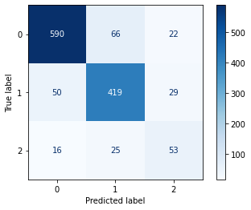
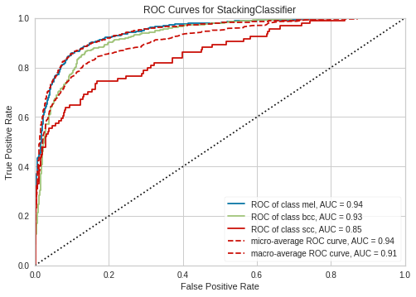
Three class Problem: Best Model
Classification Report on Validation Set (Best Model)
Class | Precision | Recall | F1-Score
0 | 0.9 | 0.87 | 0.88
1 | 0.82 | 0.84 | 0.83
2 | 0.51 | 0.56 | 0.54

Slide 34
Three class Problem: Conclusions
Winner of Three Class Classification Problem Configuration:
Without preprocessing (Hair/Vignetter Removal)
Contrast Enhancement by Histogram Equalization
Using Data Augmentation
Feature Extraction: Color Histogram
Color Space: HSV
Classifier: Stacking (Ensemble) / Random Forest (StandAlone)
The overall balanced accuracy is decent but due to very low number of samples from scc class, it hampers the overall performance.

